Slide 1
Partner Agency Meeting

Slide 2
Mute phone
Unmute when ready to speak and identify your name and CU so we know who is speaking

Slide 3
Agency Relations Team
Director of Agency Relations, Kim Bartenstein
Agency Services Coordinator, Mine Thompson
Agency Partner Network Manager, Naomi Save
Agency Partner Network Coordinator, Bridget Langaman
Community Programs Manager, Jared Kawatani
Programs Data Entry Assistant, Hiroko Sasazawa
Service Insights Coordinator, Kelly Ngo

Slide 4
Feeding America (FA) Network
Feeding America is a United States-based nonprofit organization. They are the nation’s largest domestic hunger-relief organization. Their nationwide network of more than 200 food banks feed more than 46 million people through food pantries, soup kitchens, shelters, and other community-based agencies.

Slide 5
Hawaii Foodbank’s Mission
The people of Hawaii are one ʻohana. Hawaii Foodbank provides food so that no one in our family goes hungry. We work to gather food and support from our communities. We then distribute food through charitable agencies to those in need.

Slide 6
What does FA offer?
Provides us access to:
National Donors
Food Sources
Grant Funding
Purchasing at Lower Costs
Other Resources

Slide 7
Agency Application

Slide 8
Agency Application
Agency Membership Application
Partner Agency Agreement
501(c)(3) Tax Determination Letter
Current Food Safety Certification

Slide 9
Food Safety
Designate a coordinator and provide us with their contact information
Changes or updates must be submitted to HFB within 10 days
Food safety certification
At least one person per agency (who will need to be on property at the time of distribution)
Food safety concerns
Take photos & contact the agency relations department
Food recalls
Periodic mock recalls
Agencies are required to respond to this email within 24 hours

Slide 10
Monitoring
At least annual monitoring
Site visit or mystery shopper
CSFP – annual monitoring
Funder audits

Slide 11
Hawaii Foodbank Programs

Slide 12
Agency Type
Pantry
Outreach
Snacks
Shelter
Soup Kitchen
Ohana Produce Plus

Slide 13
Hawaii Foodbank Programs
Ohana Produce Plus Program
Food 4 Keiki Programs
Government Programs
SNAP Assistance

Slide 14
Ohana Produce Plus Program
Partner agencies distribute 10 -20 pallets of fresh produce, assorted dry goods, and nonperishable items to underserved communities
~ 35 Ohana Agencies
~9-17 distributions per week
~ 51 distributions per month

Slide 15
Food 4 Keiki Programs
There are 4 programs under the Food 4 Keiki umbrella
School Pantry
Feeding Our Future
Summer Food Service Program
Child and Adult Care Food Program

Slide 16
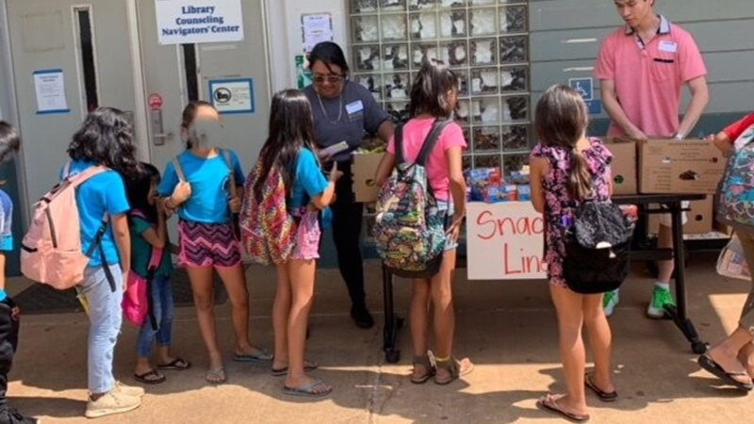
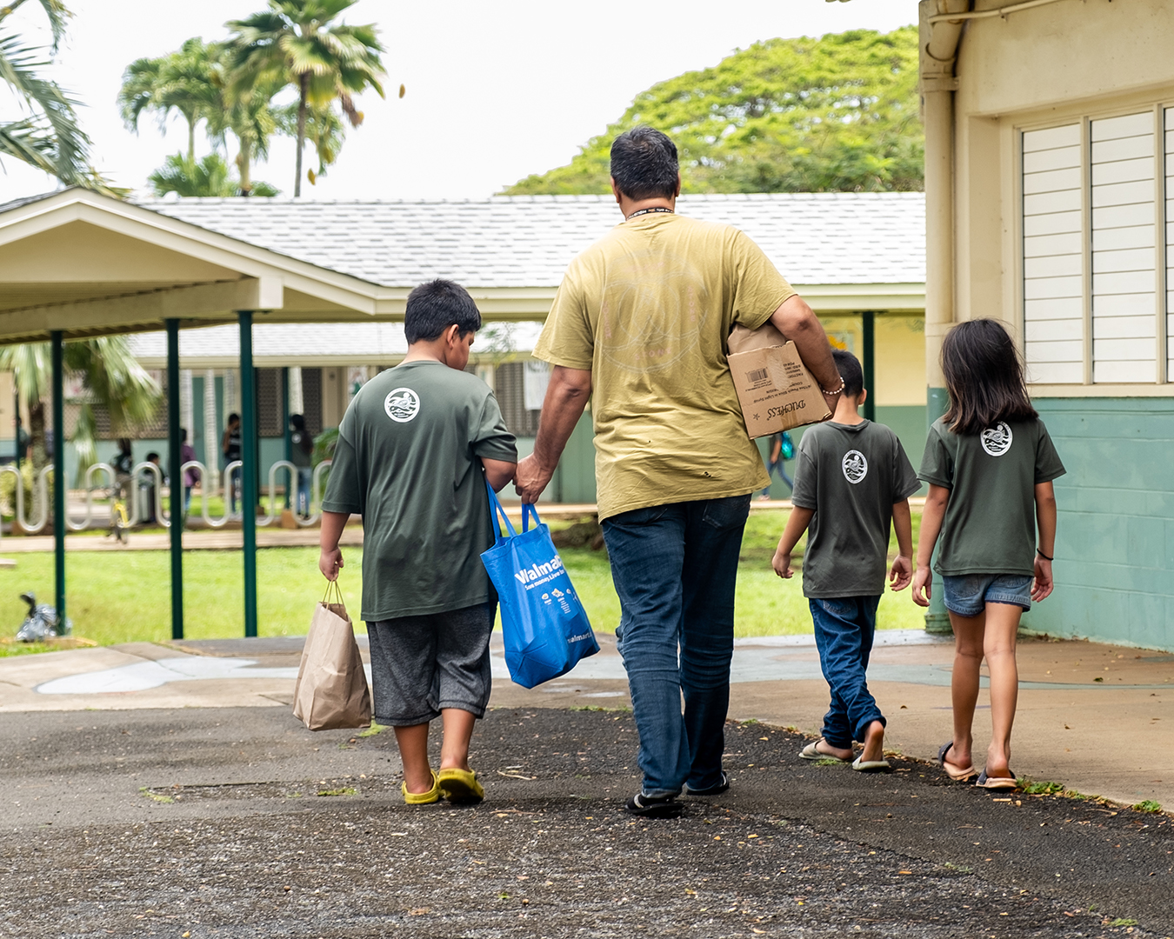
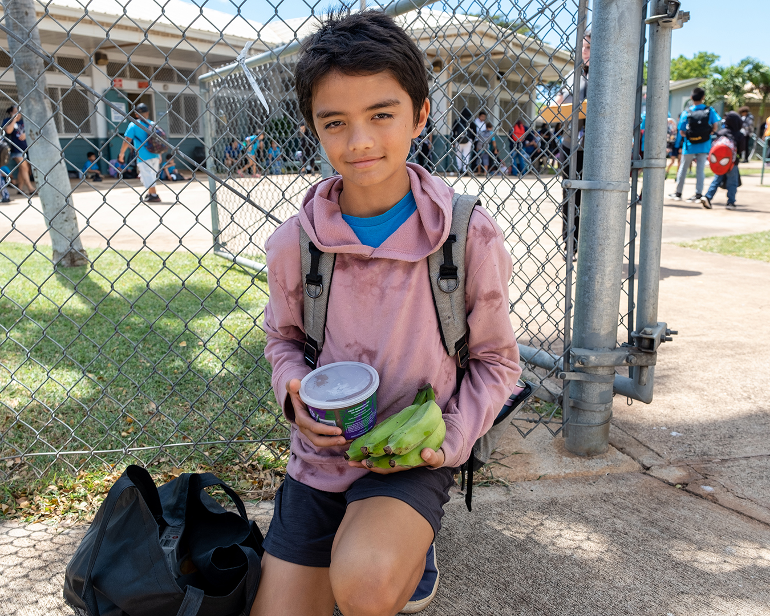
School Pantry Distributions
Hawai‛i Foodbank provides food for the School Pantry, and then the school distributes the food to students and families in their school community.
There are different models of food distribution that can be selected by the School Pantry based on their capacity and the needs of the community.
Snacks
Standard Pantry
Bags
Choice Pantry

Slide 17
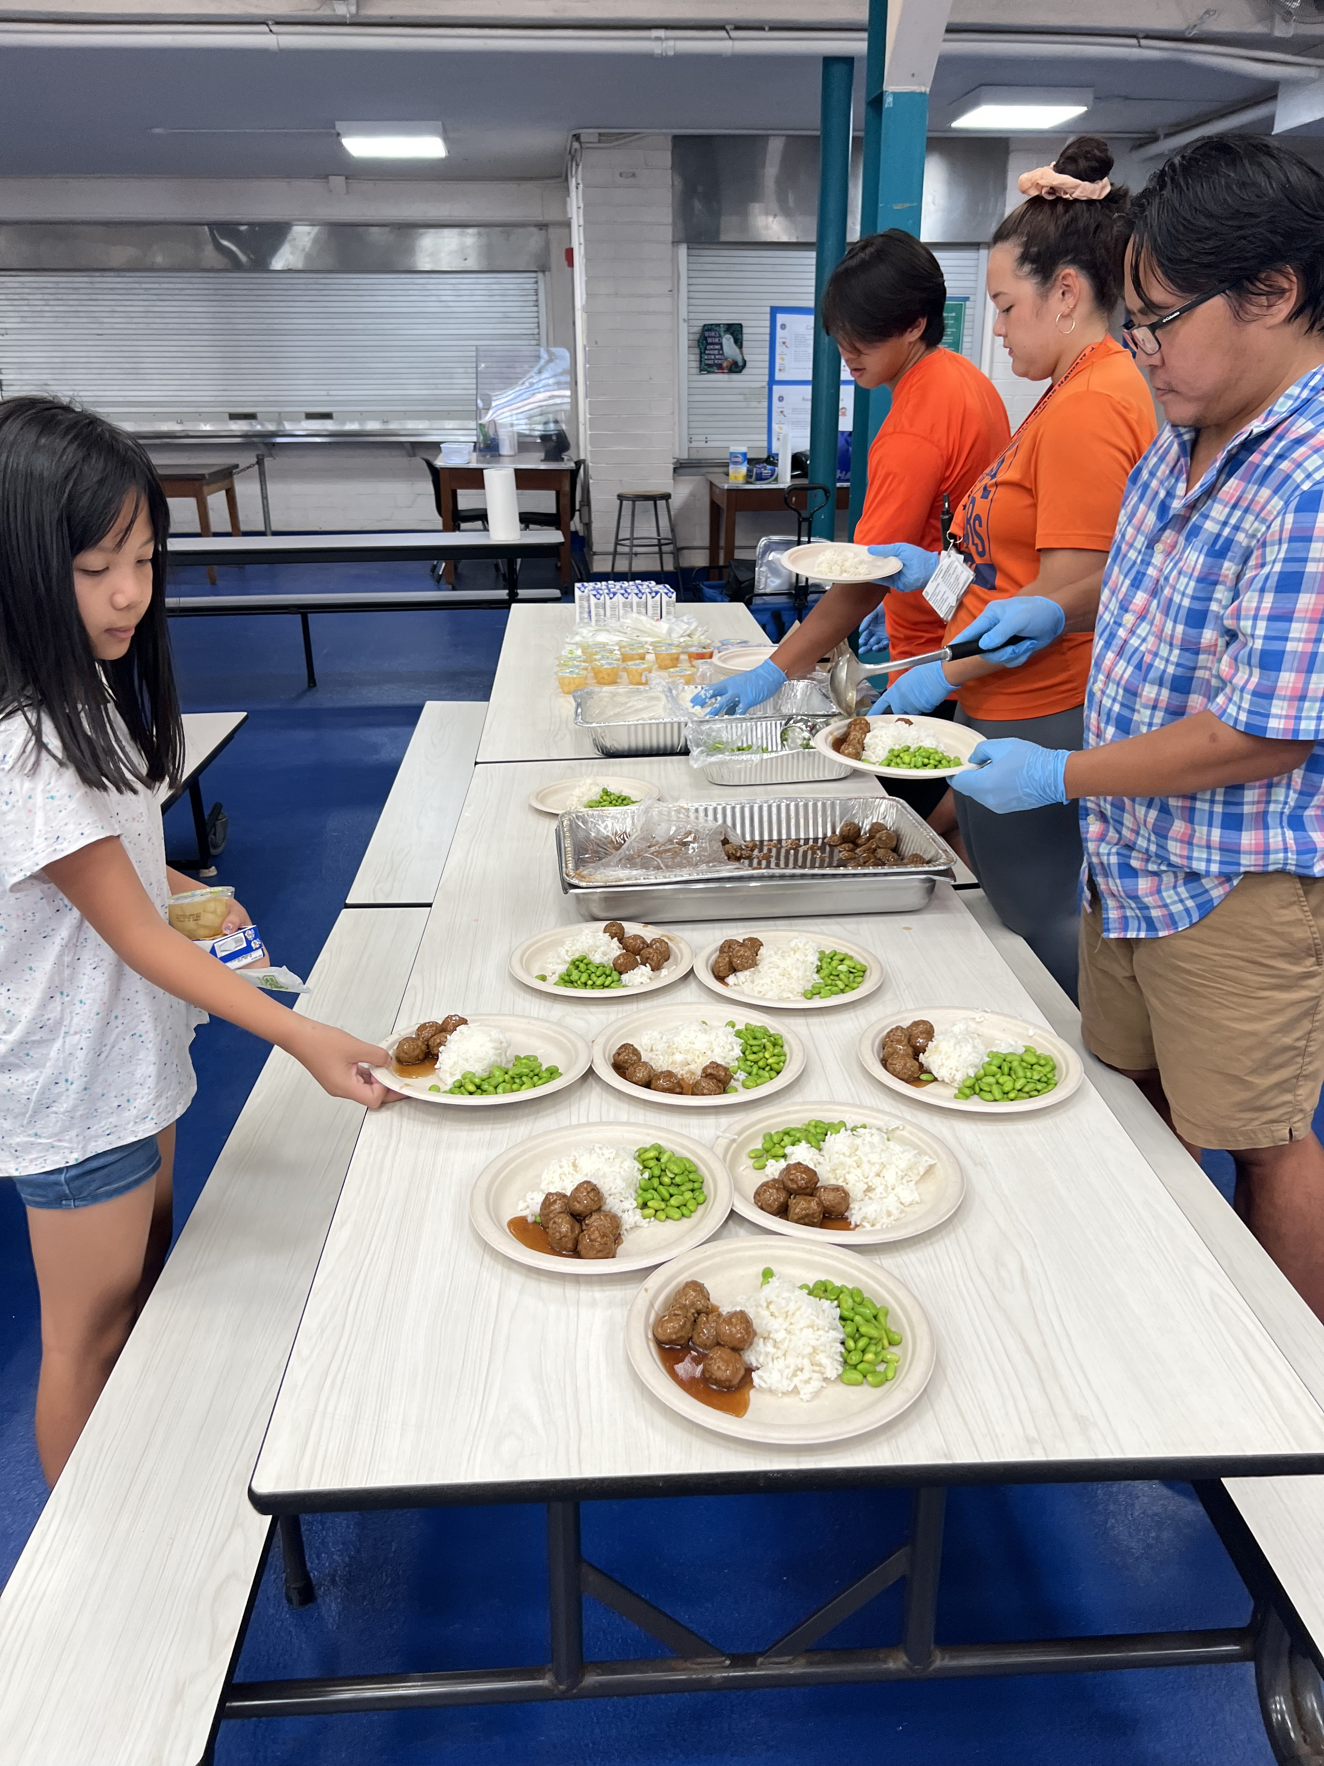
Feeding Our Future
Nationally, 29 million kids receive free or reduced-price meals during the school year, but less than 3 million continue to receive meals during the summer.
Hawai’i Foodbank partners with Sodexo Foundation and UH Manoa’s Hale Aloha Café to providing free and nutritious meals to children at risk of hunger during the summer months.
Programs pick up food at Hale Aloha Café and serve the students enrolled in their summer program.

Slide 18
Summer Food Service Program
Summer Food Service Program(SFSP) is a federal program run through the USDA.
SFSP provides reimbursements for nutritious meals and snacks served to eligible children during the summer when school is out.
Child and Adult Care Food Program
The Child and Adult Care Food Program (CACFP) is a federal program run through the USDA.
CACFP provides reimbursements for nutritious meals and snacks served to eligible children.
Children and youth participating in afterschool programs in low-income areas can receive free evening meals and snacks.

Slide 19
Keiki Program Team Contact Info
O’ahu
Director of Keiki Nutrition, Laura Zysman
Email: laura@hawaiifoodbank.org
Phone: 808-954-7885
Kaua’i
Keiki Nutritian & Outreach Specialist, Heidi Padilla
Email: heidi@hawaiifoodbankkauai.org
Phone: 808-482-2089
If you are interested in learning more about these programs, please contact Laura Zysman, director of keiki nutrition laura@hawaiifoodbank.org.
Notes:
Sonomi: How does SNAP work?
If the clients are approved for SNAP benefits, they will receive the benefits on an Electronic Benefits Transfer (EBT) card, which works like a debit card. Benefits are automatically loaded into their account each month. They can use EBT cards to buy nonprepared food items like those listed in this slide at authorized stores and retailers.
Next
1. SNAP targets benefits according to need. Households with very low incomes receive more SNAP benefits than households closer to the poverty line because they need more help affording adequate nutritious food. (The lower your net income, the more benefits you may receive).
2. SNAP can be used to help meet specific dietary and cultural needs.

Slide 20
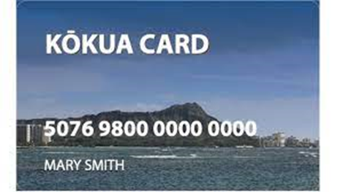
How does SNAP work?
Those who qualify receive benefits through EBT cards
Households can use SNAP to buy food items such as fruits, vegetables, protein, dairy, rice, bread, cereals, snacks and even seeds and plants to grow their own food
Notes:
Sonomi: How does SNAP work?
If the clients are approved for SNAP benefits, they will receive the benefits on an Electronic Benefits Transfer (EBT) card, which works like a debit card. Benefits are automatically loaded into their account each month. They can use EBT cards to buy nonprepared food items like those listed in this slide at authorized stores and retailers.
Next
1. SNAP targets benefits according to need. Households with very low incomes receive more SNAP benefits than households closer to the poverty line because they need more help affording adequate nutritious food. (The lower your net income, the more benefits you may receive).
2. SNAP can be used to help meet specific dietary and cultural needs.

Slide 21
The Supplemental Nutrition Assistance Program (SNAP) Outreach Program
To help people apply for SNAP benefits, Hawai’i Foodbank offers:
Pre-screening
Application assistance
Recertification assistance

Slide 22
SNAP Outreach Team Contact Info
O’ahu
SNAP Outreach Coordinator, Sonomi Espinosa
Email: sonomi@hawaiifoodbank.org
Phone: 808-265-1144
SNAP Outreach Coordinator, Eva Tavares
Email: eva@hawaiifoodbank.org
Phone: 808-265-4306
SNAP Outreach Manager, Kirsten Yale
Email: kirsten@hawaiifoodbank.org
Phone: 808-265-2250
Kaua’i
SNAP Outreach Coordinator
Email: snap@hawaiifoodbankkauai.org
Phone: 808-265-0684

Slide 23
Contracted Programs

Slide 24
Contracted Programs
Temporary Assistance for Needy Families (TANF)
The Emergency Food Assistance Program (TEFAP)
Senior Farmers’ Market Nutrition Program (SFMNP)
Commodity Supplemental Food Program (CSFP)

Slide 25
Temporary Assistance for Needy Families (TANF)
Partnership with Department of Human Services
Provide TANF products for household consumption only to low-income families, with children under the age of 18, residing in the County of Honolulu or the County of Kauai, whose total gross income is no greater than 300% of the amount specified in the 2022 Federal Poverty Guidelines
Separate reporting

Slide 26
TANF Qualifications
Household income cannot exceed 300% of the 2022 Federal Poverty Level.
Two person household – no more than $5,265 monthly – no more than $63,180.00 annually
A family has at least 1 child under the age of 18 years old living in the household.
One adult in the household must be a parent or relative of the child through blood or marriage.
ALL members of the household must be a U.S. citizen.

Slide 27
TANF Distribution Log

Slide 28
The Emergency Food Assistance Program (TEFAP)
Partnership with Office of Community Services
Helps to supplement the diets of low-income individuals or households, including elderly people, by providing them with emergency food and nutrition assistance at no cost
~110 participating agencies
Semi-Annual Inventory is required

Slide 29
TEFAP Qualifications
Are residents of the City and County of Honolulu;
Are lawfully present in the United States, but need not be citizens of the United States; and
Must not exceed 300% of the Poverty Level
One person household – no more than $51,930.00
Two person household – no more than $70,500.00 annually

Slide 30
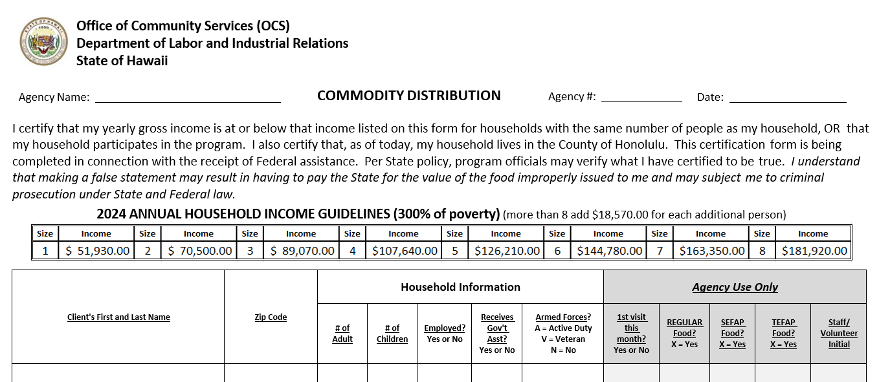
Commodity Distribution Log

Slide 31
Senior Farmers’ Market Nutrition Program (SFMNP)
Provides low-income seniors access to farm-fresh produce
Receive $5.00 voucher booklets, valued at a total of $50.00 USD
Vouchers can be redeemed at participating Farmers' Market vendors, in exchange for fresh fruits and vegetables

Slide 32
SFMNP Qualifications
At least 60 years or older
Resident of Oahu or Kauai, HFB operates this program serving kupuna on both islands
At or below 185% of the poverty guidelines
1 person - $ 32,023.50 annually
2 person - $ 43,475.00 annually

Slide 33
Commodity Supplemental Food Program (CSFP)
Better known as the Senior Food Box Program it was first launched in April 2015.
Hawaii is one of the U.S. states that participates in CSFP to distribute food boxes to supplement the diets of low-income seniors.
Boxes contain supplemental foods such as nonfat dry milk and/or UHT milk, cheese, cereal, juice, peanut butter, rice, canned meat, fruits and vegetables.
Currently have 24 distribution sites on Oahu

Slide 34
CSFP Qualifications
Age 60 years or older
Resident of Oahu or Kauai, HFB operates this program serving kupuna on both islands
Valid state or federal photo ID and mailing address
At or below 130% of the poverty guidelines (see household table on application)
1 person - $1,876 monthly or $22,503 annually
2 person - $2,546 monthly or $30,550 annually

Slide 35
Kupuna (Senior) Program Team Contact Info
O’ahu
Program Support Assistant, Aubrey Kaneshiro
Email: aubrey@hawaiifoodbank.org
Phone: 808-954-7879
Kupuna Programs Manager, Jennifer Schantz
Email: jennifer@hawaiifoodbank.org
Phone: 808-954-7868
Kaua’i
Agency/Admin Supervisor, Michelle Panoke
Email: michelle@hawaiifoodbankkauai.org
Phone: 808-482-2087

Slide 36
Civil Rights Training https://youtu.be/a8PLJnJeERA
Notes:
https://youtu.be/a8PLJnJeERA

Slide 37
Hawaii Foodbank Distribution Center

Slide 38
Partner Agency Expectations
All partners, regardless of shopping/distribution activity, must submit a Monthly Agency Activity Report by the 5th of the following month
Failure to submit complete report on time will result in your account being placed on hold. An account on hold will not be able to receive any product until the account has been brought current
All partners are required to follow all the rules set forth by HFB

Slide 39
Shopping Orientation
Scheduling appointments - must be done online
Appointments cannot be scheduled within 24 hours or more than one week in advance
Partner Agencies may only visit the distribution center once per day, with a max of two visits per week
Same day appointments are not allowed
Parking – agency parking stalls are marked (stalls 11 – 21), you are allowed to use two (2) stalls during your appointment time
ID Cards/Authorized Shoppers
An authorized shopper is someone your organization has appointed to sign the invoices
The authorized shopper will be issued a shopper ID card – see agency relations office
Helpers will need to be issued a paper badge – see agency partner services coordinator
Adding and removing authorized shoppers on the account needs to be done in writing (email is acceptable)
Shopping List – when you come to pick up food the scalers will weigh you out and have you sign the shopping list (this is not your invoice. After you load your items in your vehicle, please return to sign your invoice (a copy will be given to you).
Invoices - every time you receive food from Hawaii Foodbank you should be signing an invoice and receiving a copy for your records
Statements – statements are mailed monthly to the billing address provided in writing if there is a charge amount
Payments – invoices/statements must be paid with an Agency check
HFB does not accept personal checks, credit card payments or cash

Slide 40
Distribution Center Rules
Follow all Distribution Floor/Shopping Rules posted
Maximum of three shoppers per agency - one (1) shopper needs to be an authorized shopper
Shoppers must wear closed-toe shoes (the top of the foot and the heel should be covered)
Shoppers must be at least 16 years old
Women over six (6) months pregnant are not allowed to shop
Shoppers are allowed to use up to three (3) carts per agency
Do not open case lot items – if you are unsure, please ask warehouse staff for assistance
While in the chill area, all shoppers must wear gloves when touching exposed produce
When taking refrigerated and frozen product you must bring a cooler, thermal blanket or refrigerated vehicle to ensure safe transport
This is a working warehouse, please be aware of your surroundings at all times
All product originating from HFB is to be used exclusively for the agency you represent and is not for sale or personal use

Slide 41
Keeping Records
All files must be kept for 3 years – Notice will be sent out when files can be destroyed. Scanned copies of these items are allowed.

Slide 42
Monthly Reporting

Slide 43
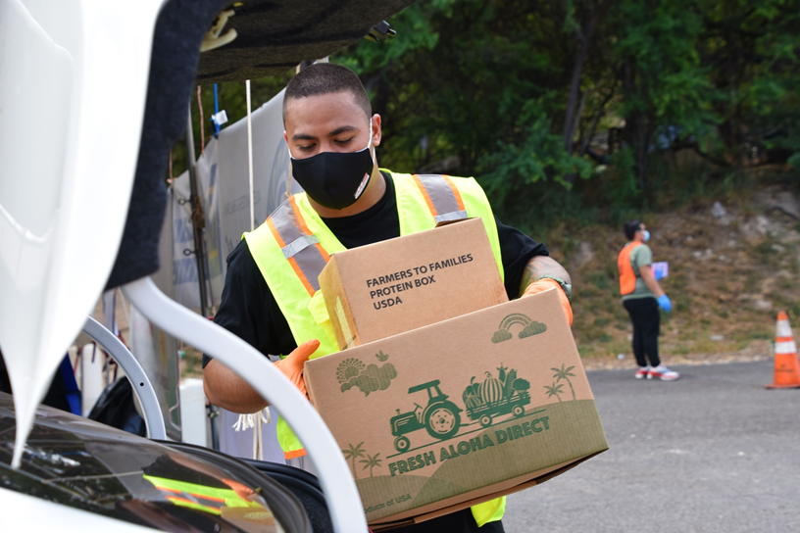
Questions?
Together, we can work to ensure no on in our Hawaii 'ohana goes hungry.

Slide 44
Agency Relations Team Contact Info
Director of Agency Relations, Kim Bartenstein
Email: kim@hawaiifoodbank.org
Phone: 808-954-7870
Agency Services Coordinator, Mine Thompson
Email: mine@hawaiifoodbank.org
Phone: 808-954-7863

Slide 45
Agency Relations Team Contact Info (cont.)
Agency Partner Network Manager, Naomi Save
Email: naomi@hawaiifoodbank.org
Phone: 808-954-7864
Agency Partner Network Coordinator, Bridget Langaman
Email: bridget@hawaiifoodbank.org
Phone: 808-954-7882

Slide 46
Agency Relations Team Contact Info (cont.)
Community Programs Manager, Jared Kawatani
Email: jared@hawaiifoodbank.org
Phone: 808-954-7877
Programs Data Entry Assistant, Hiroko Sasazawa
Email: hiroko@hawaiifoodbank.org
Phone: 808-954-7867
Service Insights Coordinator, Kelly Ngo
Email: kelly@hawaiifoodbank.org
Phone: 808-954-7876

Slide 47
Agency Relations Department Emails
Monthly Reports
monthlyreports@hawaiifoodbank.org
Agency Relations
agencyrelations@hawaiifoodbank.org
Invoicing
invoicing@hawaiifoodbank.org

Slide 48
Thank you for your hearts and your commitment to serve.
Mahalo

